Slide 1

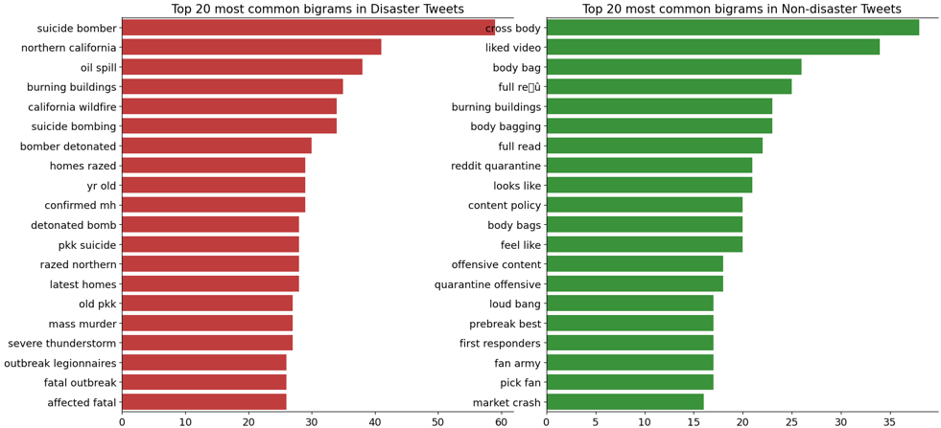
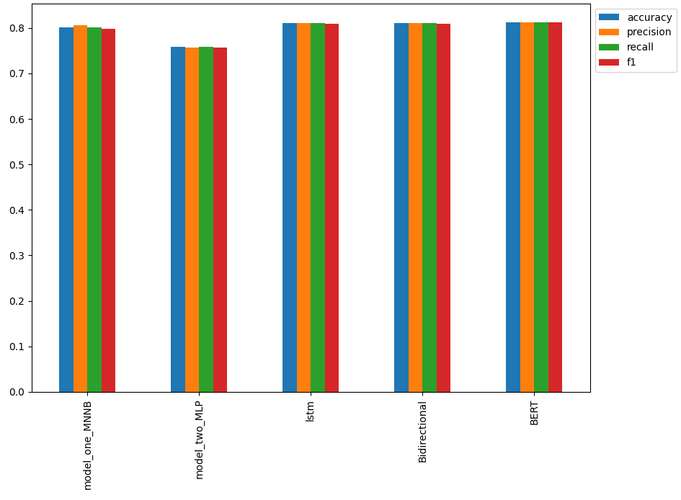
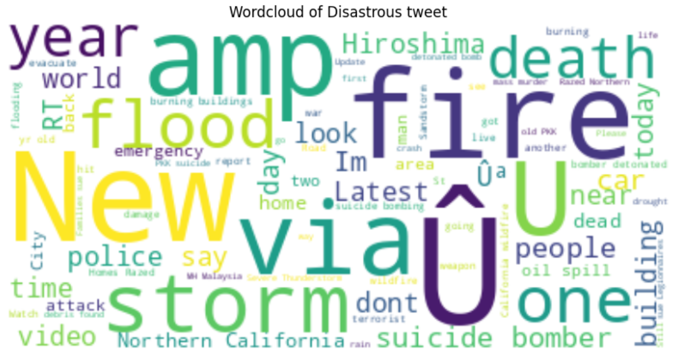
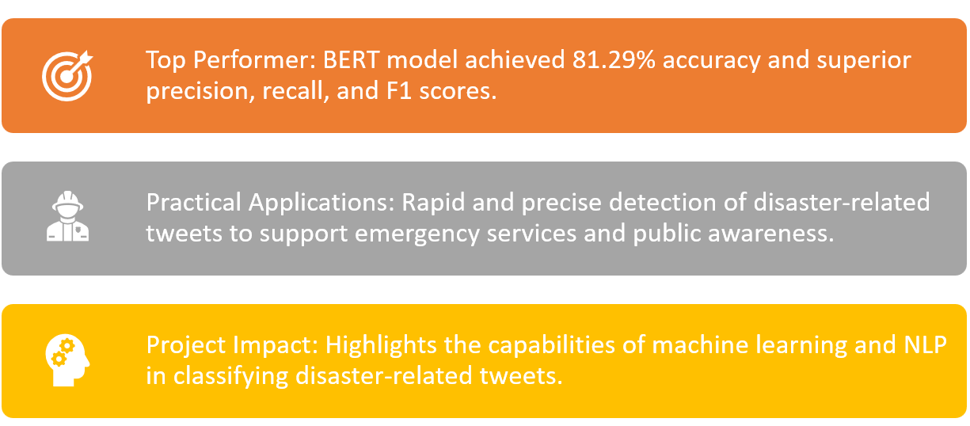
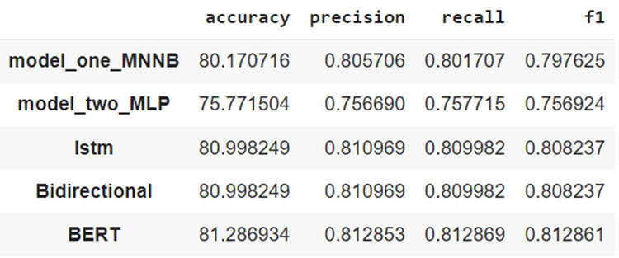
NLP-based Tweet Classification for Improved Disaster Response
Phanindra Vantipalli
G21483618
Master in Computer Science
Department of Computer Science
Abstract
Methodology
Results
Conclusion
In the age of social media, the rapid dissemination of information during natural disasters is crucial for saving lives and enabling efficient emergency response. The right information can make a significant difference in disaster management efforts. In this study, I developed an ML model to accurately classify tweets related to natural disasters using advanced NLP techniques and deep learning models. I compared the performance of various machine learning models, including Naïve Bayes, MLP Classifier, LSTM, Bidirectional LSTM, and BERT. The BERT model achieved the highest F1 score of 0.81, indicating its superior performance in classifying disaster-related tweets. This research demonstrates the potential of using NLP and machine learning for improving disaster response and management, ultimately contributing to the global effort to enhance the effectiveness of emergency services and public awareness during natural disasters.
The dataset used in this project consists of 7,613 observations, with each observation labeled as either disaster-related or a regular tweet. To ensure the best performance of our model, I carried out a comprehensive exploratory data analysis to understand the characteristics of disaster and non-disaster tweets. I found that disaster-related tweets had a higher character count and words typically associated with catastrophes. This insight helped us design our data preprocessing pipeline, which included removing usernames, URLs, punctuation, stop words, emojis, and numbers from the text.
I then proceeded to test various machine learning models for the classification task. These models included Naïve Bayes, MLP Classifier, LSTM, and BERT. For each model, I used the preprocessed text and converted it into a suitable vector format (Tf-Idf for Naïve Bayes and MLP Classifier, Word Embeddings for LSTM, and BERT). I then compared the models based on their F1 score, which is a balance between precision and recall.
Upon evaluating the different machine learning models, I found that the BERT model outperformed all others, achieving an F1 score of 0.81. Naïve Bayes, LSTM, and Bidirectional LSTM had similar F1 scores around 0.80, while the MLP Classifier scored the lowest with 0.75. The results indicate that the BERT model offers the best performance in classifying disaster-related tweets, highlighting its potential in real-world applications.
The successful classification of disaster-related tweets using the BERT model can significantly aid emergency services and public awareness during natural disasters. The results of this project showcase the importance of NLP and machine learning techniques in disaster management, potentially leading to improved response times and better coordination of resources.
The BERT model demonstrated superior performance in classifying disaster-related tweets, achieving an accuracy of 81.29% and higher precision, recall, and F1 scores compared to other models. The results of this project emphasize the potential of using ML and NLP techniques for improving disaster response and management, ultimately contributing to the effort to enhance the effectiveness of emergency services and public awareness during natural disasters. This research also highlights the capabilities of BERT and other deep learning models in capturing the nuances of language and context, enabling them to better understand and classify textual data. These findings have broad implications for the development of machine learning models for various NLP tasks, including sentiment analysis, named entity recognition, and machine translation. Moving forward, further optimizations to the model, as well as the incorporation of additional relevant features and data sources, may help improve the accuracy and effectiveness of disaster-related tweet classification, ultimately benefiting disaster management and emergency response efforts worldwide.
Introduction
Rapid and accurate information dissemination is crucial during natural disasters, as it directly affects the emergency response and public awareness. In recent years, social media platforms such as Twitter have become an important source of real-time information during disasters. In this project, our primary goal is to develop a machine learning model capable of classifying tweets related to disasters with high accuracy. By leveraging state-of-the-art NLP techniques and deep learning models, I aim to enhance the classification performance and contribute to the global effort of disaster management.
Additionally, understanding the characteristics of disaster-related tweets and differentiating them from non-disaster tweets is essential for the development of an effective classification model. Through the exploratory data analysis, I delved into the features of disaster and non-disaster tweets, providing insights that would help improve the model's performance. The methodology section describes the data preprocessing steps, model building, and evaluation process.
References
Loper, E., & Bird, S. (2002). NLTK: The natural language toolkit. In Proceedings of the ACL-02 Workshop on Effective Tools and Methodologies for Teaching Natural Language Processing and Computational Linguistics (pp. 63-70).
Pedregosa, F., Varoquaux, G., Gramfort, A., Michel, V., Thirion, B., Grisel, O., … Duchesnay, E. (2011). Scikit-learn: Machine Learning in Python. Journal of Machine Learning Research, 12, 2825-2830.
Hutto, C. J., & Gilbert, E. (2014). Vader: A Parsimonious Rule-Based Model for Sentiment Analysis of Social Media Text. In Eighth International Conference on Weblogs and Social Media (ICWSM-14). The AAAI Press.
Pennington, J., Socher, R., & Manning, C. D. (2014). GloVe: Global Vectors for Word Representation. In Proceedings of the 2014 Conference on Empirical Methods in Natural Language Processing (EMNLP) (pp. 1532-1543). doi: 10.3115/v1/D14-1162

